Slide 1

Regression
MODULE – 3

Slide 2
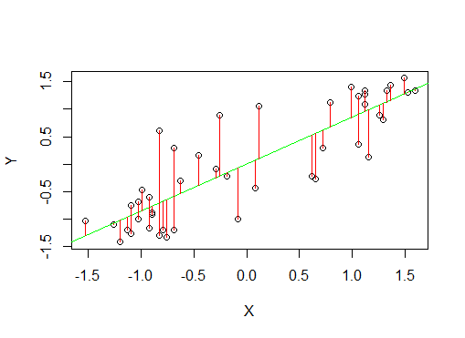
Regression and Residuals
The residuals of a regression model are the errors on given data.

Slide 3
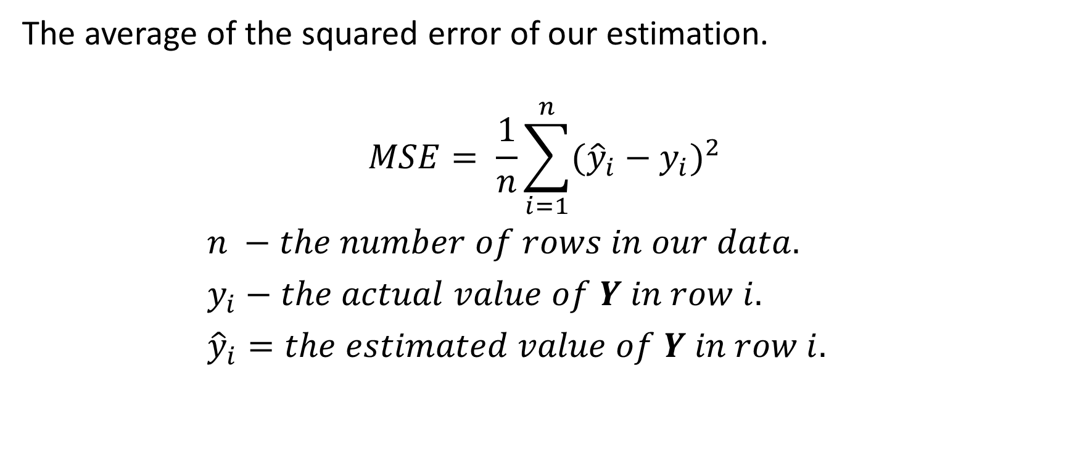
Mean Square Error
The average of the squared error of our estimation.
$$MSE= \frac{1}{n}\sum_{i=1}^{n}{{({\hat{y}}_{i}−y_{i})}^{2}}$$
$n −the number of rows in our data.$
$y_{i}−the actual value of Y in row i.$
${\hat{y}}_{i}=the estimated value of Y in row i.$

Slide 4
Ordinary Least Squares (OLS) Regression
Creates the linear model that minimizes the sum of residuals squared (on the training data).
"Line of best fit"
Constructor:
lm
Important Tuning Parameters:
None
Example:
model=lm(Y~.,trainingData)
est=predict(model,newData)

Slide 5
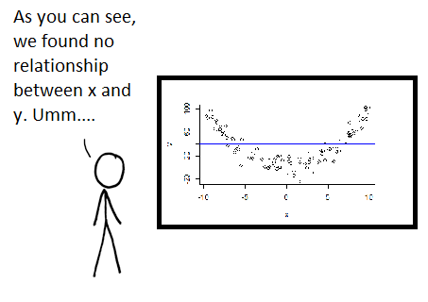
The real world is seldom linear
Problem: OLS works great if the target variable is linearly related to the input features. But most data is non-linear.
One solution: Look at the linear relationship between non-linear transformations of our variables.

Slide 6
Poisson Regression (Generalized Linear Models)
One option is to work with transformations of our target variable.
This gives us the class of models known as generalized linear models. The transformation is known as the link function.
An example is Poisson regression (AKA log-linear regression), which assumes a linear relationship between the input features and the logarithm of the target variable.
Useful when the target is a count variable, where the counted events are independent and the probability per unit time of counted events are related to input features. (Note the estimate is always positive.)
For example, the time between arrivals of customers at a bank. We assume the arrival of one customer does not make another more or less likely, but the number of customers depends on features such as the time of day.

Slide 7
Poisson Regression
Constructor:
glm
Important Tuning Parameters:
Constructor:
We must specify the link function to use using the family argument. Unusually, this comes between the formula and training data. For Poisson regression the link function is "poisson".
Predict function:
By default the output of the predict function when using a glm model are transformed values. In the Poisson case, we get the logarithm of the target variable. To instead get the actual value of the target variable we must specify type="response".
Example:
model=glm(Y~.,"poisson",trainingData)
est=predict(model,newData,type="response")

Slide 8
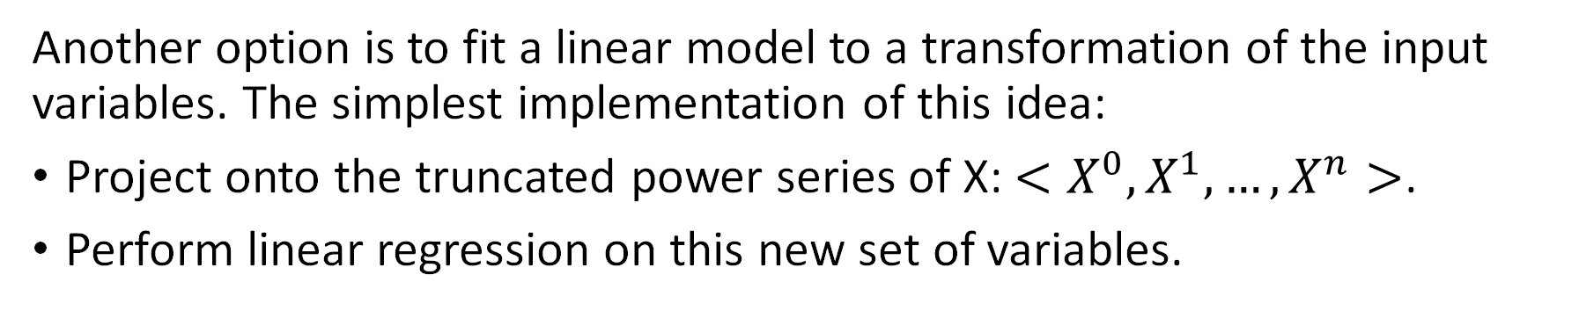
Polynomial Regression
Another option is to fit a linear model to a transformation of the input variables. The simplest implementation of this idea:
Project onto the truncated power series of X: $<X^{0},X^{1},…,X^{n}>$.
Perform linear regression on this new set of variables.
When there are multiple input features, the power series includes cross-terms. So a projection onto the second order power series of <X1,X2> gives <X1,X2,X1*X2,X1^2,X2^2>. We will look primarily at cases of a single input feature.

Slide 9
Polynomial Regression
We get our estimate of Y by performing OLS on the new dataset <X',Y>
We project our input features onto their power series.
X | Y
1 | 7.5
2 | 12.6
5 | 60.9
... | ...
X'1 =X | X'2 =X^2 | X'3 =X^3 | … (As many orders as desired) | Y
1 | 1 | 1 | ... | 7.5
2 | 4 | 8 | ... | 12.6
5 | 25 | 125 | ... | 60.9
... | ... | ... | ... | ...
Original Data
Original Features
(Original coordinate system)
New Data
Transformed Features
(New coordinate system)

Slide 10
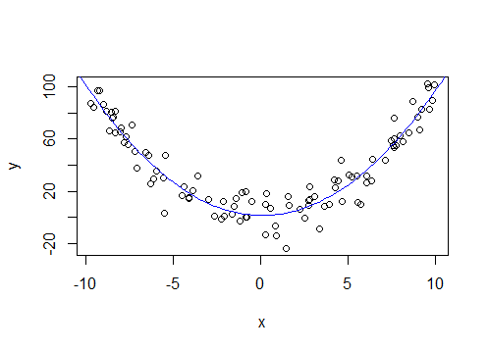
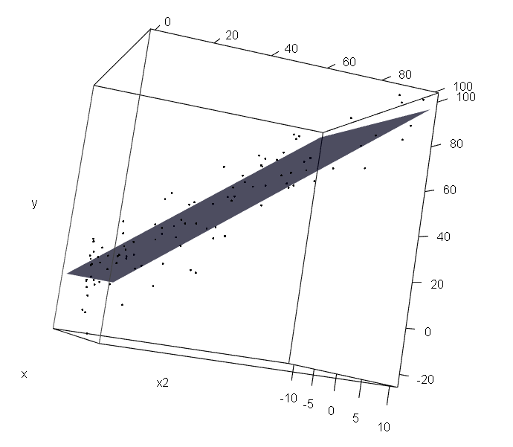
Polynomial Regression
Original Data
Original Features
(Original coordinate system)
New Data
Transformed Features
(New coordinate system)
Regression curve is polynomial (of chosen order) in the original coordinate system.
Regression curve is linear in the transformed coordinate space

Slide 11
Polynomial Regression
Constructor:
lm (using poly in formula)
Important Tuning Parameters:
Constructor:
Where we want to project individual variables onto their power series we can use the lm function with the poly function in the formula. The order of the polynomial projection must be given for each projected variable. See example.
(NB To project onto the joint power series of multiple variables - with cross-terms - you will need to manually create new data frames.)
Example:
model=lm(Y~poly(X,4),trainingData)
model=lm(Y~poly(X1,2)+poly(X2,3),trainingData) # NB - No cross terms
est=predict(model,newData)

Slide 12
Reflections
We seek a transformation of our original variables such that the relationship between the target variable and the transformed input features is linear.
Projecting onto the power series is powerful, but looking at the full power series of multiple variables creates a lot of cross-terms.
We could look an any transformation of our original variables.
Perhaps we could learn useful transformations from the data?

Slide 13
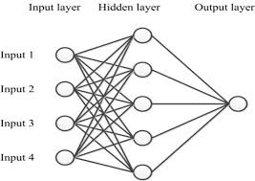
Neural Networks (Regression)
Neural networks provide a way of learning optimal non-linear transformations from the training data.
They consist of:
An input layer, representing the input features
One or more hidden layers, each of which is just a new set of variables that are a non-linear transformation of the previous layer
An output layer, which in the regression case just estimates the target variable by performing linear regression on the final hidden layer.

Slide 14
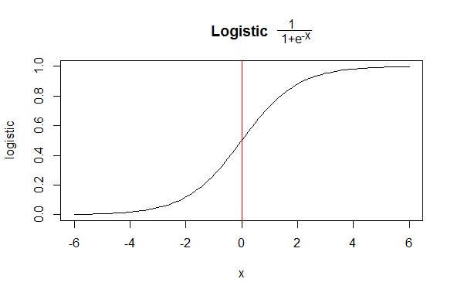
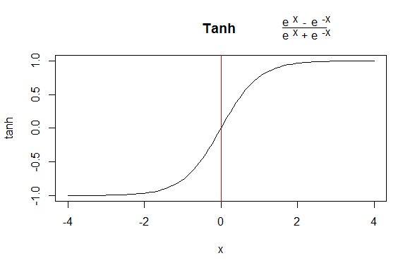
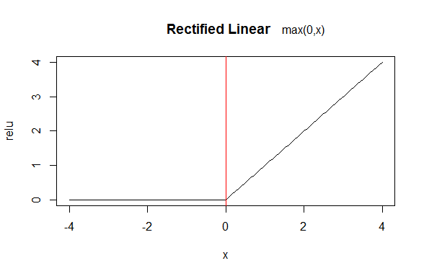
Neural Networks: Common Neurons
n
Σ
X0
H= f ( WiXi)
W0
i=0
X1
W1
H
W2
X2
...
X0 is a dummy variable that always equals 1. It is sometimes called the bias.
Wn
Xn

Slide 15
Neural Networks (Simple)
Constructor:
nnet (in package nnet)
NB For advanced deep learning, use package mxnet. See our Applied Deep Learning with MXNetR Workshop.
Important Tuning Parameters:
Constructor:
size: Number of nodes in the hidden layer. Only one hidden layer permitted.
maxit: Maximum iterations to use for training. Default is 100.
linout: Should the output layer be a linear regression layer. Should be TRUE for regression models. Default is FALSE.
decay: L2 regression parameter. Default is 0.
Example:
model=nnet(Y~X,trainingData,size=10,linout=TRUE)
model=nnet(Y~X,trainingData,size=10,linout=TRUE,maxit=10000,decay=.1)
est=predict(model,newData)

Slide 16


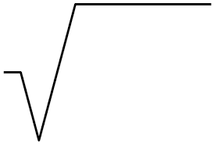
Error Distributions
Regression models provide point estimates
We obtain a distribution by using an error function
is a stochastic function that models the distance of actual values from those estimated by the model f
Often modelled by a normal function with zero mean and standard deviation calculated from the residuals, r:
^
Y=f(X)+
Σ
r
2
= N( 0 , )
____
N-1

Slide 17
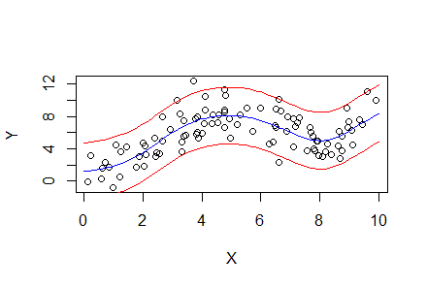

Normal Error Functions
Given a normal distribution $N\left(x,μ,σ^{2}\right)$:
$$P\left(\left|x−μ\right|≥2σ\right)≈95.4\%$$
$$P\left(\left|x−μ\right|≥3σ\right)≈99.7\%$$
So we can provide ’error bars’ around our estimates.

Slide 18


Confidence Intervals
Given an error function we can:
Provide confidence intervals around our estimates
Calculate the probability of events given our model
We can calculate them from the distribution.
If the error distribution is normal, then:

Slide 19
Normal Error Distributions and Confidence Intervals: Example Code
est=predict(model,data)
err=est-Y
stddev=sqrt(sum(err^2)/(length(err)-1))
# Using 2 std deviations
lowerCI=est-2*stddev
upperCI=est+2*stddev
# Using 95% of the density of the normal distribution
lowerCI=est+qnorm(.025,0,stddev)
upperCI=est+qnorm(.975,0,stddev)

Slide 20
Training-Selection-Test
Ideally, you should not use the training data or the data used to select competing models (see next module) to analyze expected performance. They will overestimate expected accuracy.
Abnormality
Sometimes the error function is clearly not approximately normal, though generally this is a sign that OLS models (and models that are OLS models of transformations of the raw features) are inappropriate.
Many residuals outside three standard deviations of the mean.
Techniques exist, such as working with Chebyshev’s inequality for bounds.

Slide 21
Exercise 1
Using the Ozone data from the datasets package. Use only the Wind and Ozone columns, and remove all rows with a missing (NA) Ozone value.
Create linear regression and Poisson regression models.
Calculate the mean squared error (on the training data) for each model.

Slide 22
Exercise 2
Using the poly4 data from the course code. Set the random seed to 0 before using the getPoly4 function.
Create linear regression, polynomial regression models of orders 2 to 6 and two neural network models with four hidden nodes. Set the random seed to 0 and 1 before building the neural net models.
Make a function to plot the data and a model and use it to plot these models.
Make a new function like the last but which also provides confidence intervals around the regression curve.

